Slide 1

Office of Mineral Resources
Online Reporting & Document Access
Taletha Shorter –Audit Manager
Beverly Kahl – Land Specialist 3

Slide 2
Office of Mineral Resources
Comprised of three divisions:
  Executive
  Geology, Engineering & Lands
  Mineral Income

Slide 3

Office of Mineral Resources
Mineral Income Division- Royalty Reporting Section
Primary duty is to process state royalty reports
  Manually
  Online
Online reporting is mandated for all payors remitting more than $25,000 in the previous calendar year
  Excel upload
  Text upload

Slide 4
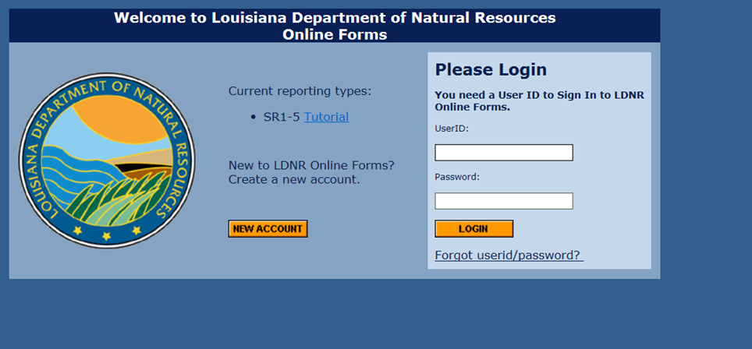
Office of Mineral Resources
Mineral Income Division- Royalty Reporting Section
Link to online reporting is: http://sonlite.dnr.state.la.us/sundown/cart_prod/olde_dnr?pformtype=SR

Slide 5
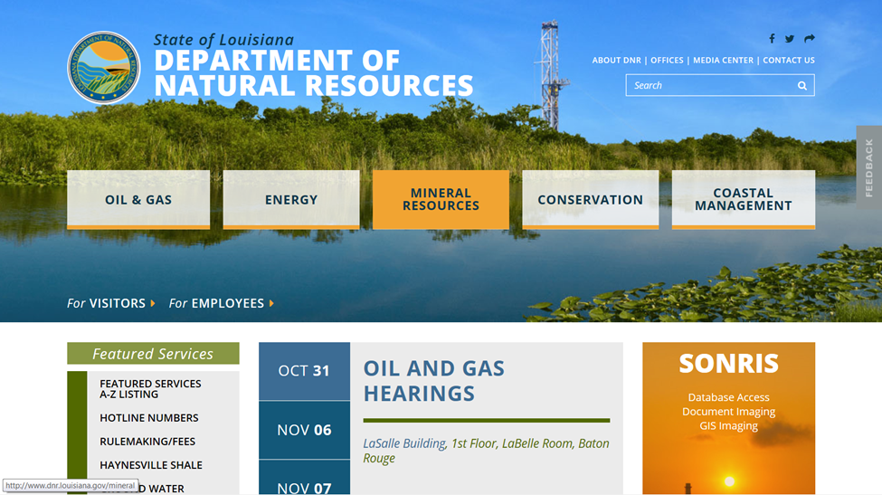
Office of Mineral Resources

Slide 6
Office of Mineral Resources
Mineral Income Division- Royalty Reporting Section
How-To Guide
Royalty due dates are the 25th of each month
Payments exceeding $50,000 must be by ACH or wire transfer
Pertinent forms, instructions, and manuals

Slide 7
Office of Mineral Resources
Mineral Income Division- Royalty Reporting Section
Please contact Taletha Shorter at 225-342-3069 or taletha.shorter@la.gov for additional royalty reporting info or help

Slide 8
Office of Mineral Resources
Document Access
  State royalty reports
  Leases
  Assignments
  Releases
  Survey plats
  Board minutes

Slide 9
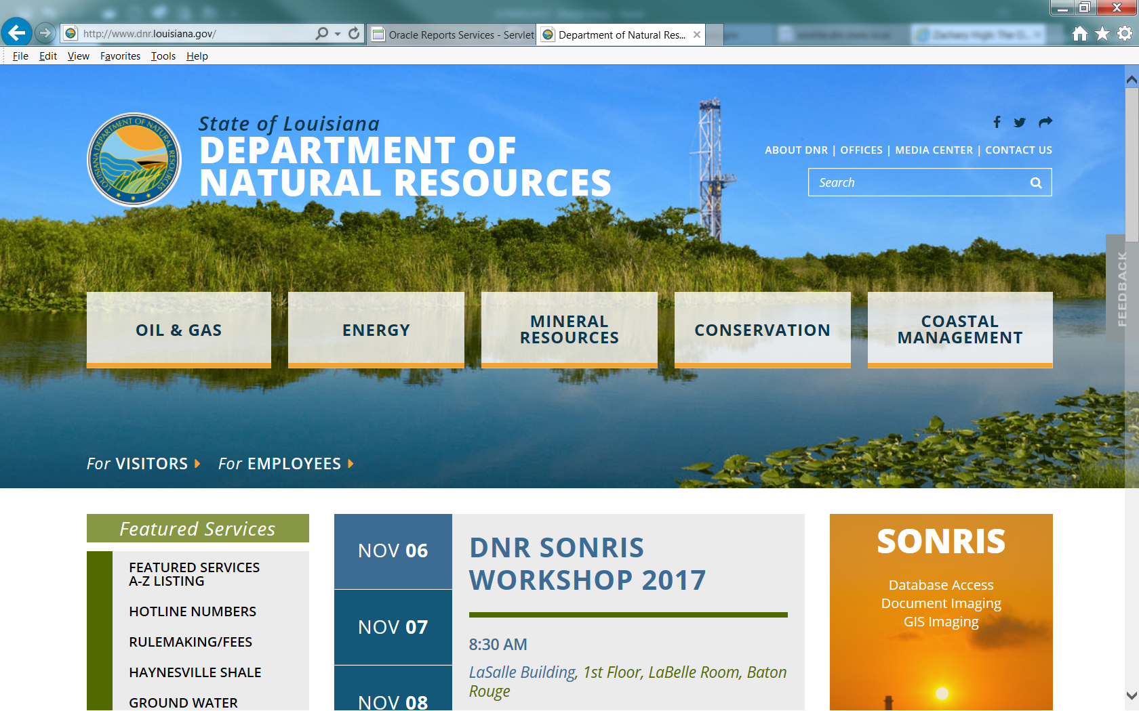
Office of Mineral Resources
Document Access

Slide 10
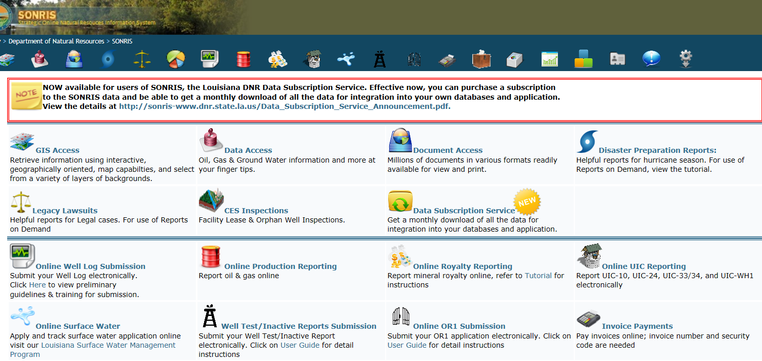
Office of Mineral Resources
Document Access

Slide 11
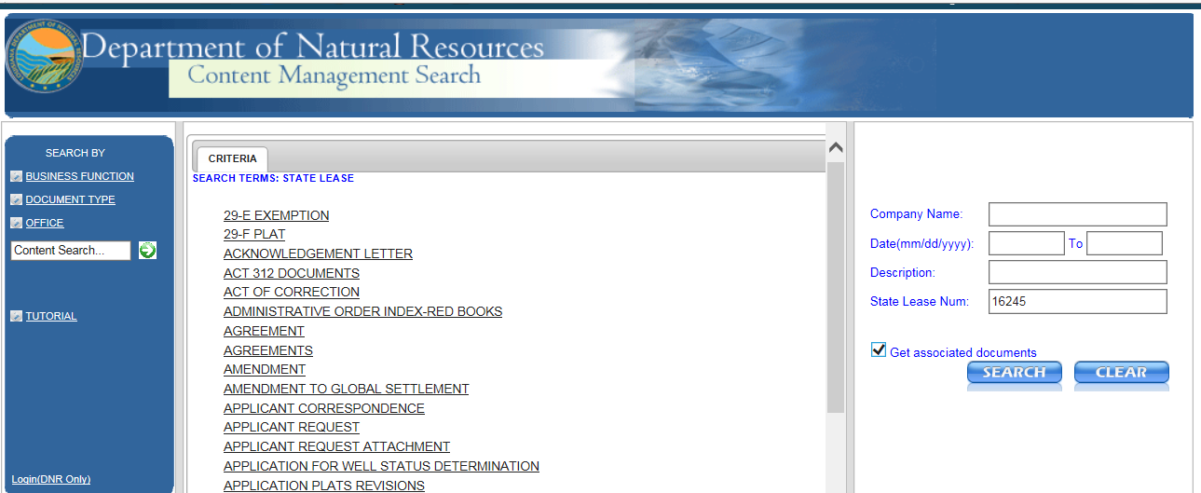
Office of Mineral Resources
Document Access

Slide 12
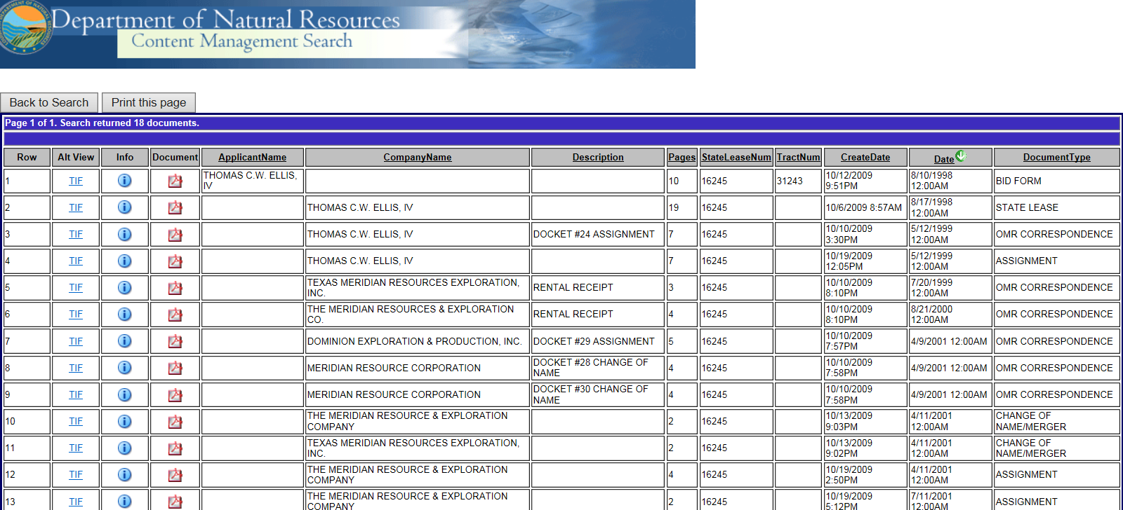
Office of Mineral Resources
Document Access

Slide 13
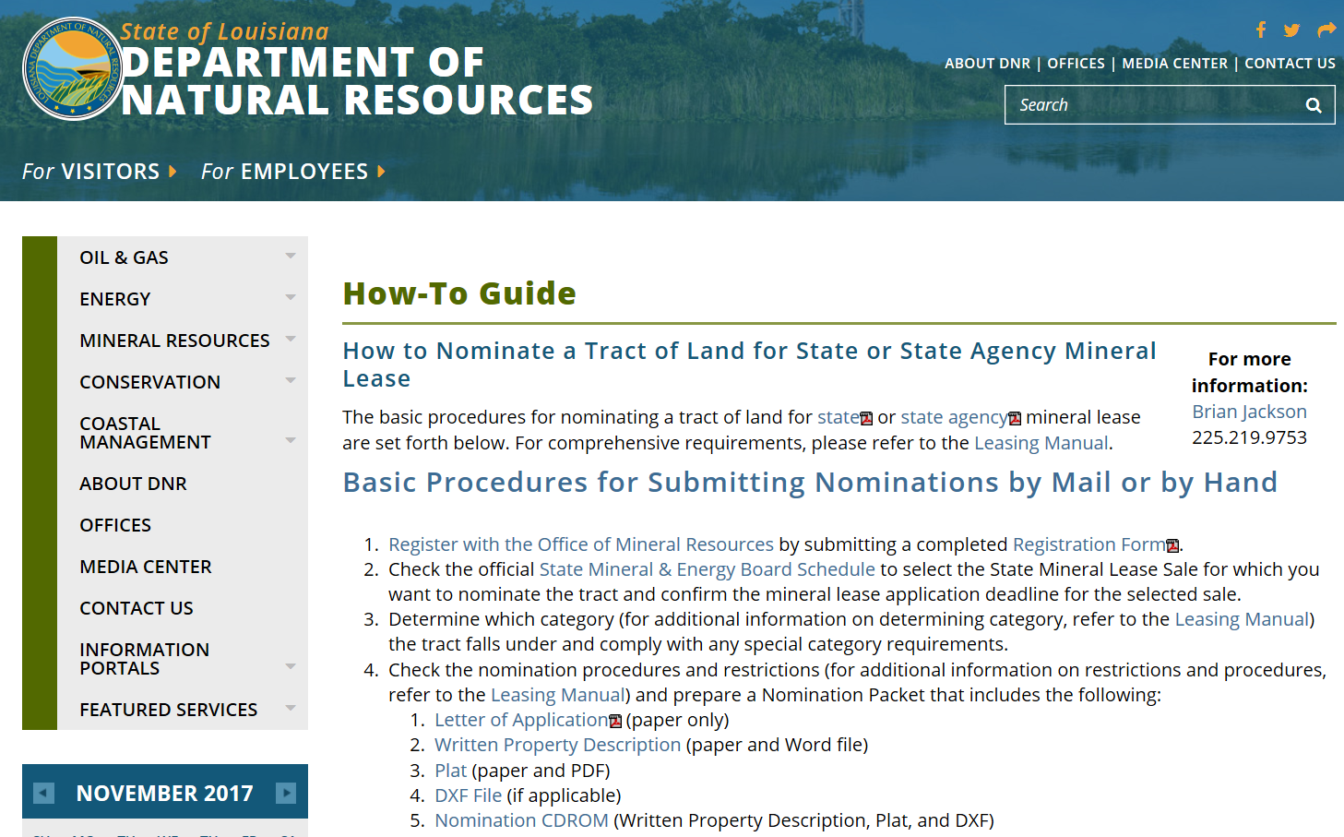
Office of Mineral Resources
Mineral Leasing

Slide 14
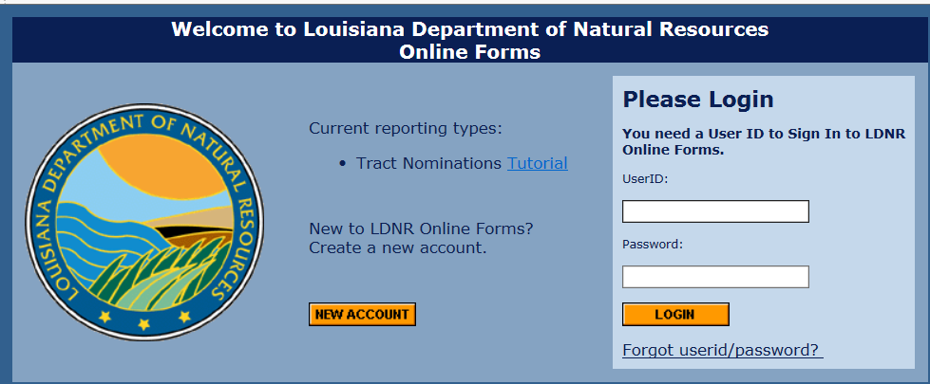
Office of Mineral Resources
Online Nominations

Slide 15
Office of Mineral Resources
Petroleum Lands Division- Docket and Lease Ownership Section
Please contact Beverly Kahl at 225-342-4618 or beverly.kahl@la.gov
for document access info or help

